Slide 1

All you need to know…

Slide 2
Objectives
The Medical Training Survey gathers feedback from doctors in training in Australia to:
Understand
Better understand the quality of medical training in Australia
1
Identify and improve
Identify how best to improve medical training in Australia
2
Recognise and respond
Recognise and deal with potential issues in medical training that could impact on patient safety, including environment and culture, unacceptable behaviours and poor supervision.
3

Slide 3





Guiding principles
1
7
Quality improvement
Participation
2
6
Safe and
confidential
Reporting and
using results
3
Focused
on training
Reflection
and feedback
4
5
Access
Notes:
There are seven guiding principles for the Medical Training Survey:
1. Quality improvement: The MTS is a quality improvement tool, to strengthen medical training in Australia.
2. Safe and confidential: Medical trainees and supervisors can safely and confidentially participate in the MTS. Participants’ data will be de-identified in any reporting of results, and only de-identified data will be provided to the Board and AHPRA.
3. Focused on training: The core focus of the MTS is on post-graduate medical training.
4. Reflection and feedback: The MTS encourages participants to reflect on their medical training and teaching and provide feedback safely to support continuous improvement. Reflective practice is a cornerstone of good medical practice and of the Professional Performance Framework.
5. Access: The MTS will be relevant to medical training and not onerous to complete. It will be accessible online and easy to use, to encourage participation.
6. Reporting and using results: The results of the MTS will be published in the interests of transparency. Specialty and jurisdiction specific reports from MTS data will be generated as far as possible, while assuring participant confidentiality. Stakeholders will apply survey results to improve medical training.
7. Participation: The annual MTS will evolve, initially seeking feedback from doctors in training and in time their supervisors. It aims to reduce the need for other surveys about the same issues.

Slide 4
Stakeholders
Working together to create the Medical Training Survey
Postgraduate Medical Councils
Medical Deans of Australia and NZ
Ahpra
Employers
Doctors in training
Doctors’ Health Services
Medical Council of New South Wales
Medical Board of Australia
Specialist colleges
Australian Medical Council
Health departments
Educators
Australian Medical Association
Australian Indigenous Doctors’ Association
Notes:
MTS was the idea of doctors in training, educators and employers
It is the result of a joint effort from doctors in training, specialist colleges, employers, health departments, educators, the AMA, Doctors’ Health Services, Postgraduate Medical Councils, Australian Indigenous Doctors’ Association, the AMC , the Medical Council of NSW, the Medical Board and AHPRA.
The Medical Board of Australia and Ahpra are making it happen.
The Medical Board established a Steering Committee and an Advisory Group to support the development of the survey.
The advisory group includes representatives from doctors in training, jurisdictions, Australian Medical Association, Australian Medical Council, Australian Indigenous Doctors’ Association, Doctors Health Services, Directors of Clinical Training, Postgraduate Medical Councils, Medical Deans of Australia and New Zealand and the Medical Board

Slide 5




Five groups of junior doctors
= five survey versions
Interns
Prevocational & unaccredited trainees
Specialist
trainees (non-GP)
Specialist
GP trainees
IMGs
Notes:
There are 5 versions of the MTS, one each for.
Interns
Prevocational and unaccredited trainees
Specialist trainees (non-GP)
Specialist GP trainees
IMGs
Nearly 80% of questions are common across all surveys, the rest are tailored to each group of junior doctors.
The MTS builds on existing junior doctor surveys conducted by jurisdictions and colleges
The MTS generates national, cross profession data that is being used to improve medical training.

Slide 6

What’s new in 2020?
Notes:
Based on stakeholder feedback, we have revised a couple of questions in the 2020 MTS and include a question on COVID-19.
We have updated questions about bullying and harassment, to give a clearer picture and enable more targeted work to help build a culture of respect in medicine.
We are taking advantage of the unique opportunity the MTS gives to find out about the impact of COVID-19 on medical training in Australia in 2020.

Slide 7
Survey topics: What the MTS covers
Demographic
Training post
Events
workplace environment and culture, access to teaching, clinical supervision and wellbeing
Training program
curriculum, assessment, engagement with trainees
Overall satisfaction
Patient safety
Future career intentions
COVID-19
Notes:
Routine survey questions fall into six broad topics and ask for junior doctor feedback on the following issues:
Demographic
Training program curriculum
Training program assessment
College engagement with trainees
Workplace environment and culture
Access to teaching
Clinical supervision
Training post orientation
Wellbeing
Patient safety
Overall satisfaction
Future career intentions
About you
Survey questions are tailored to the needs of each group of junior doctors.

Slide 8
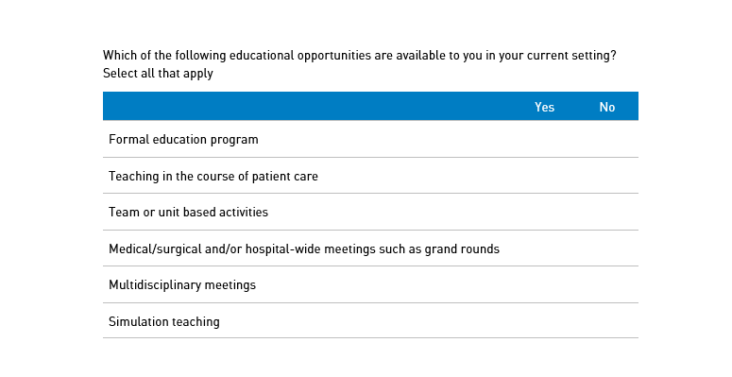

Survey questions: What the MTS asks
Notes:
No free text box
All multiple choice – some yes no answers; some likert scale
About 50 questions per survey
Takes 10 – 15 minutes

Slide 9


How to do the survey
Interns
IMGs
Email from the Medical Board of Australia with a unique survey link
Notes:
Two options to participate:
Interns and IMGs will get an email from the Medical Board of Australia with a unique survey link

Slide 10
How to do the survey
Prevocational & unaccredited trainees
Specialist trainees (non-GP)
Specialist GP trainees
Renewal of registration
Notes:
All other groups of junior doctors do the survey when they renew their medical registration in August – September:
First register
Then do the Workforce Survey
Then do the Medical Training Survey.

Slide 11
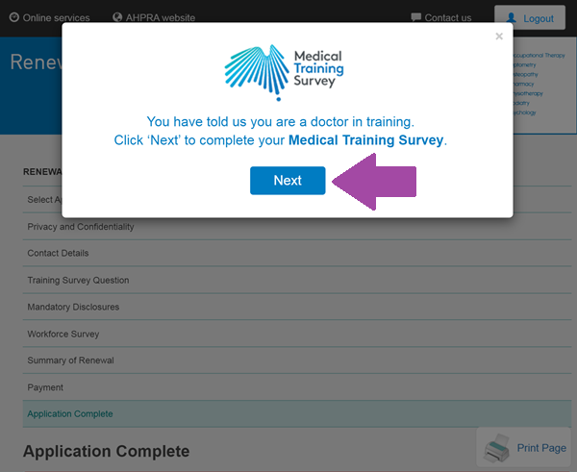

Where is my survey link?
Notes:
For those renewing their registration, your survey link will appear at the end of registration. A pop-up box will appear. Simply click ‘next’ to start your Medical Training Survey!
If you miss this pop-up box, your link can be found on your confirmation of registration webpage in a red box, or if you miss this, it will be sent to you in your confirmation of registration email.

Slide 12
MedicalTrainingSurvey.gov.au
Notes:
There is a dedicated MTS website, with loads of information about the survey, including 2019 results
All you need to know about the Survey is published on the website!

Slide 13
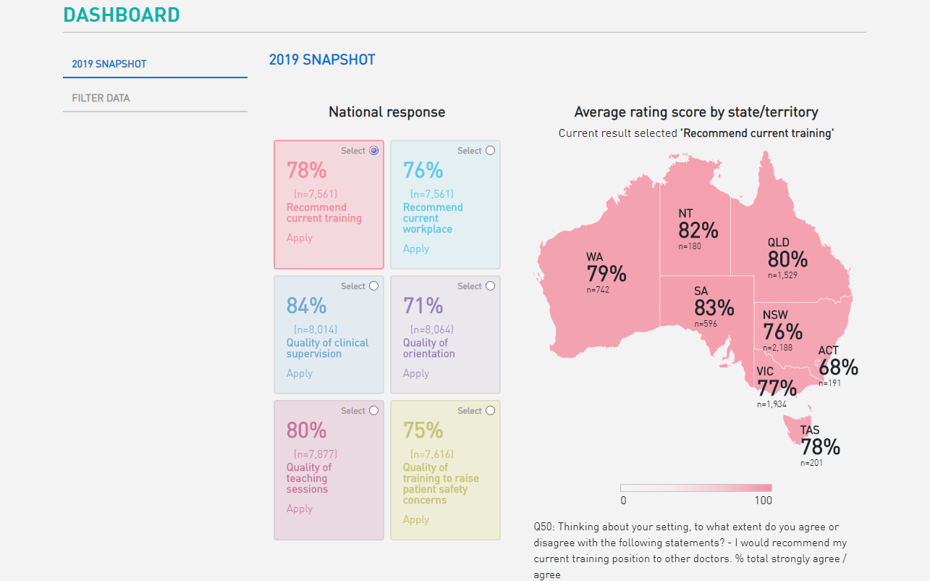
Interactive online data dashboard
Notes:
The website also houses the results of the 2019 survey. We encourage you to look at the 2019 results. The 2019 results are now available on the website as:
Published static reports
You can also create a tailored report through the interactive online dashboard
The dashboard is easy to navigate and use
Compare with national averages (optional)
No data displayed when <10 responses for that question
Reports include detailed analysis for the national questions
Tailor reports with optional filters:
State/Territory
Hospital/non-hospital
Remote, rural and metropolitan
Type of doctor in training (Interns, prevocational trainees, Specialist non-GP trainees, Specialist GP trainees, IMGs)
Specialist medical college
Gender
Post Graduate Year

Slide 14
Please promote the Medical Training Survey
Notes:
More survey participants = stronger data
We want to keep increasing participation rates
Please do all you can to promote awareness and participation
Get active and support the MTS on social media
Do the MTS and tell your friends, colleagues and trainees to do it
The more junior doctors who do the survey, the richer and more complete the data.
Please encourage doctors in training to do the survey.
The MTS builds on existing junior doctor surveys by jurisdictions and colleges
The MTS is the only survey that will generate national, cross profession data that can be used to improve medical training.

Slide 15



Promotional materials
Notes:
To help you promote the MTS we have many materials available for you to access and send out. This includes:
Podcast on how the 2019 results have been used and why it’s important to do the 2020 MTS
Videos from doctors in training and why they’ll be doing the MTS this year and why it’s important other doctors in training complete the survey. All videos are easy to share on social media
Fact sheet answering all the important elements of the survey, such as when it will be run, what happens with the data and how the results will be published.

Slide 16

Opens early August 2020
For more information visit: www.MedicalTrainingSurvey.gov.au

